Slide 1


Instruction Format Session No.: Course Name: Computer Organisation and Architecture Course Code: RIUC305 T Duration: 50 MIN Date of Conduction of Class:

Slide 2
Opening Activity
When you tell a computer to add two numbers, how do you think this instruction is stored inside the CPU – as words, symbols, or in a fixed binary pattern?"

Slide 3
Learning Objectives
Define what an instruction format is in computer architecture.
Identify the key fields of an instruction (opcode, operands, addressing mode).

Slide 4
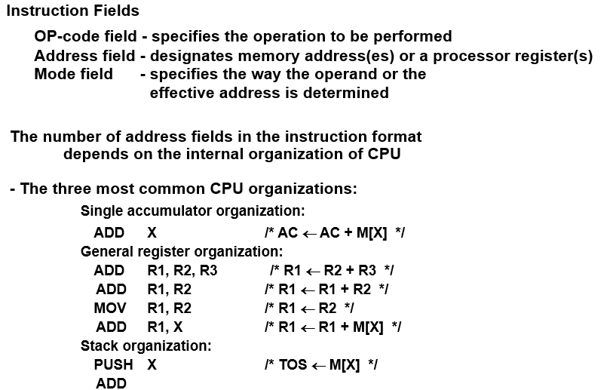
Instruction Format
Instruction Fields

Slide 5
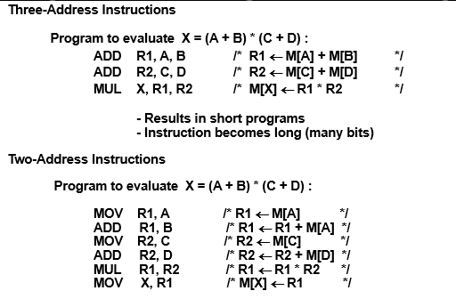
THREE, AND TWO-ADDRESS INSTRUCTIONS

Slide 6
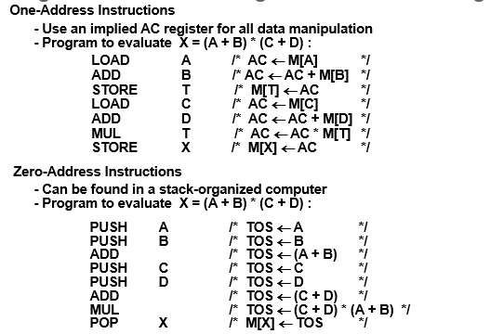
ONE, AND ZERO-ADDRESS INSTRUCTIONS

Slide 7
Summary of Key Points
Instruction format = blueprint of an instruction.
Contains opcode + operand(s) + addressing mode.
Different formats: 0, 1, 2, 3-address.
Plays a key role in CPU efficiency and program execution.

Slide 8
Reflection Activity
Imagine you are designing your own CPU. Which instruction format (0-address, 1-address, 2-address, or 3-address) would you prefer and why?

Slide 9
Closing Slide
Takeaway: Instruction format = blueprint of an instruction.
Next Topic: Addressing Modes

